Slide 1
Welcome To York Code Dojo
David Betteridge @da_betteridge
Yorkdevelopers.org
@yorkdevelopers
@yorkcodedojo

Slide 2
Agenda
Quick Introduction
Explain the problem
Work in pairs till 8.45pm
Opportunity to show off solutions
Pub about 9pm

Slide 3
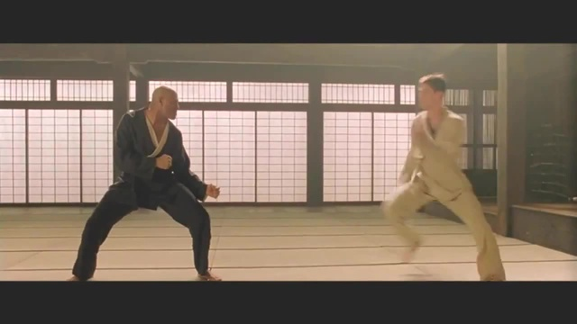
Code Dojo
Notes:
Who has been to a code dojo before?
What is the point?
It’s a place to practice coding safely. By that we mean it doesn’t matter if you haven’t solved the problem by the end of the evening. No one will judge you on it. It’s a place to practice, learn and try out new things.
For example you could use a language you have never used before, partner with someone new, try a different approach to solving the problem. You could add your own constraints; like my functions won’t have more than three lines; or I’m not going to use any IF statements.
(It’s also meant to be fun) It’s driving a car to work every day, you might cover a lot of miles, but if you are doing the same journey then does your driving ability really improve?
It’s driving a car to work every day, you might cover a lot of miles, but if you are doing the same journey then does your driving ability really improve?

Slide 4
Tonight – Share Trading
Choice of activities:
Analysis of data
Share Trading
Notes:
I don’t know much shares other than you can buy and sell them!

Slide 5
Analysis
There are two data files containing a list values over time.
Can you analysis the files to find meaning in the data and predict if the price will go up or down?

Slide 6
Trading
You have been given £10,000 to invest in a range of shares.
The value of these shares will change during the evening
The idea is to make as much money as possible.
Trading is done using calls to a REST api on a server
Notes:
Show Swagger
Show C# Example

Slide 7
York Developers
York Tech Fest – 13th November
Games Developers (Last Thursday of the month)
Code and Coffee (Monday and Wednesday mornings)
Agile York (3rd Wednesday of the month)
Dot Net York

